Slide 1
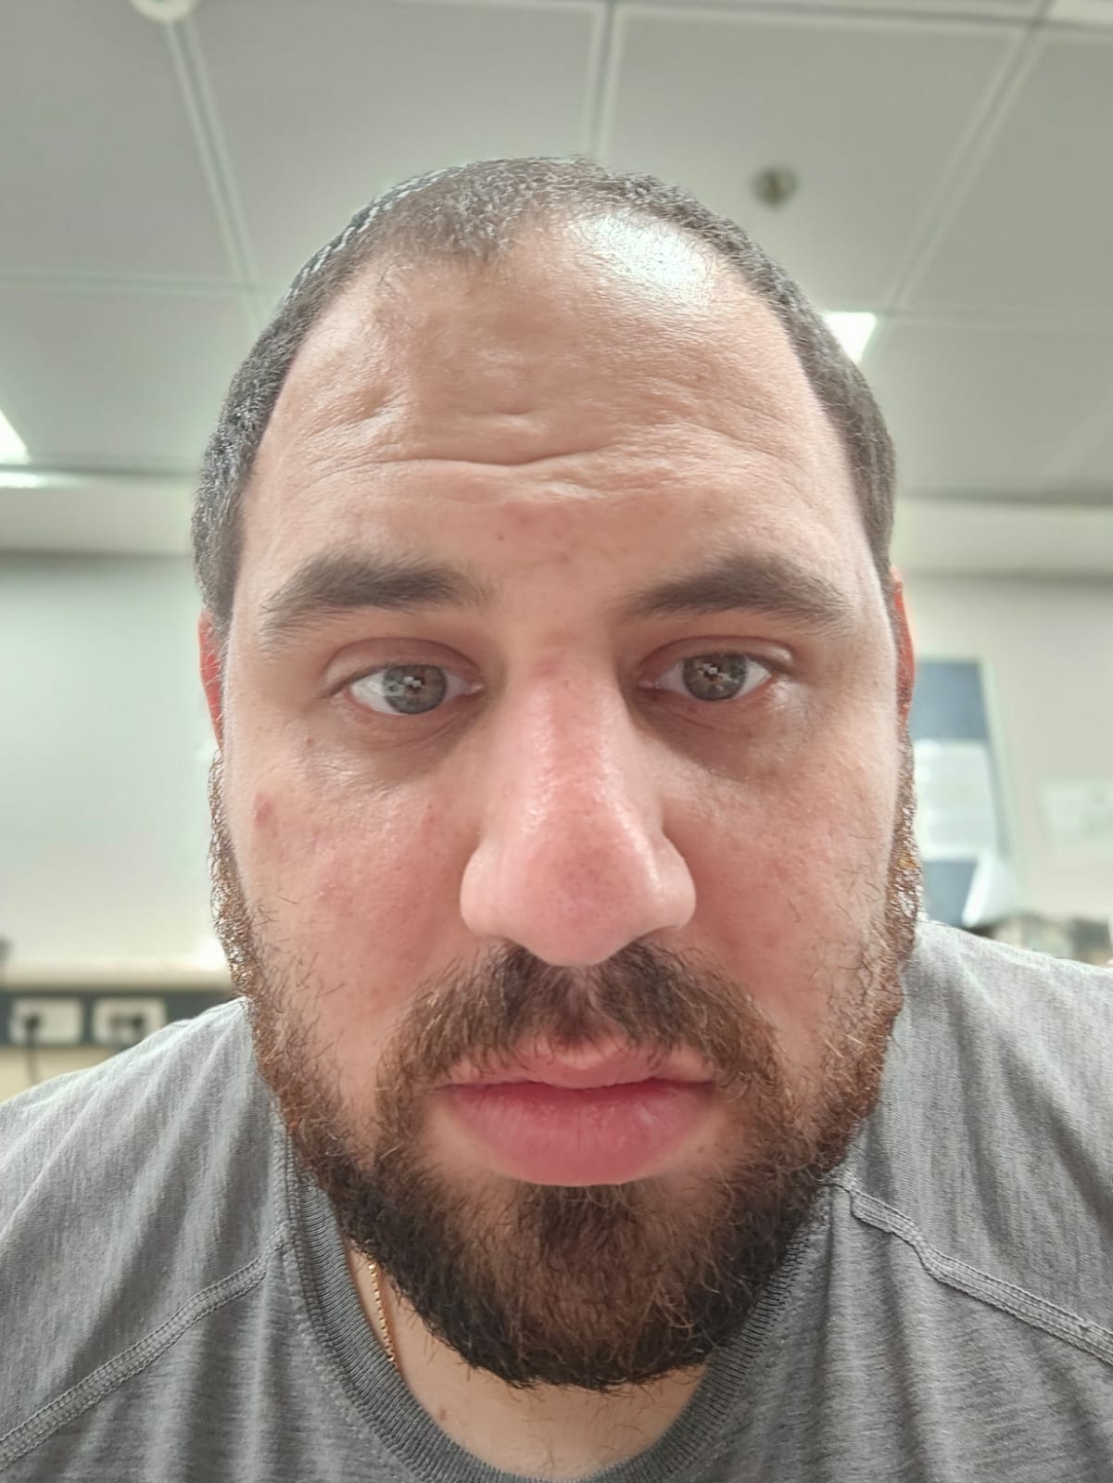
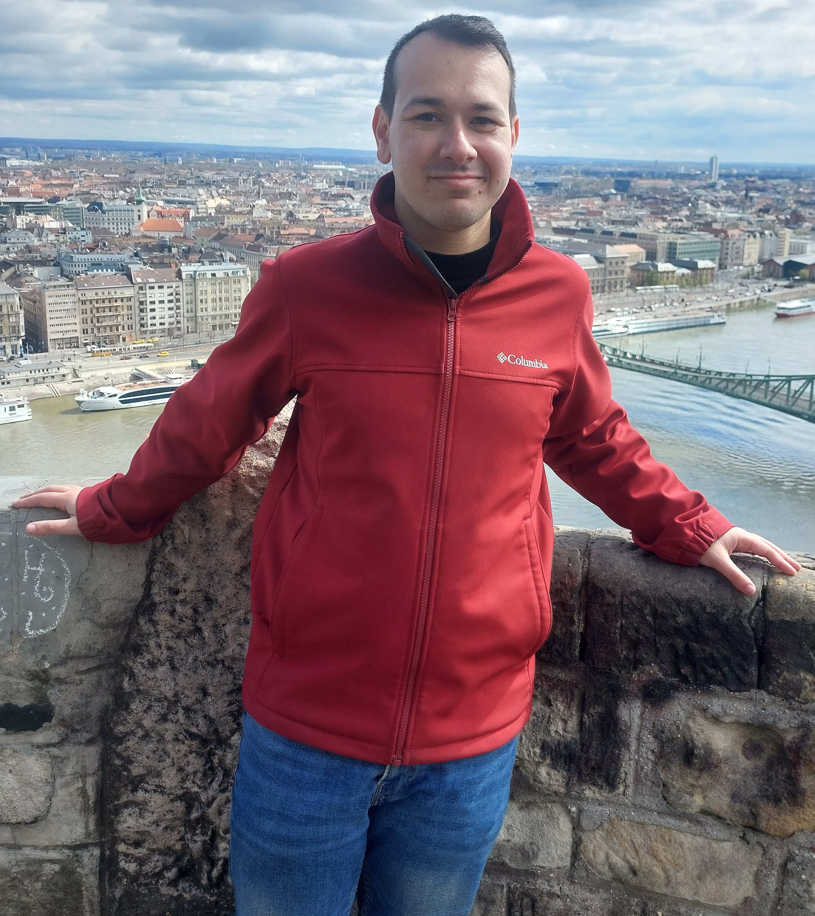
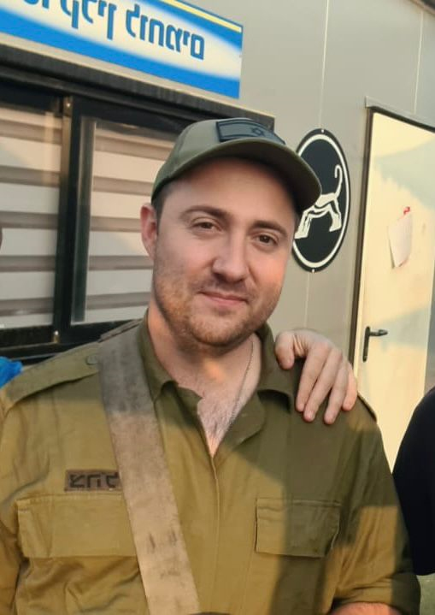
Course: Image Processing 31651 Assignment #13 Synthetic Image Creation (Part 3)
Photo of the student | Shorten Name | ID (4 last digits)
 | shienfeld | 1950 | Student #1
 | pony | 2210 | Student #2
 | akimov | 7939 | Student #3
Photo of the student | Shorten Name | ID (4 last digits)
 | shienfeld | 1950 | Student #1
 | pony | 2210 | Student #2
 | akimov | 7939 | Student #3

Slide 2
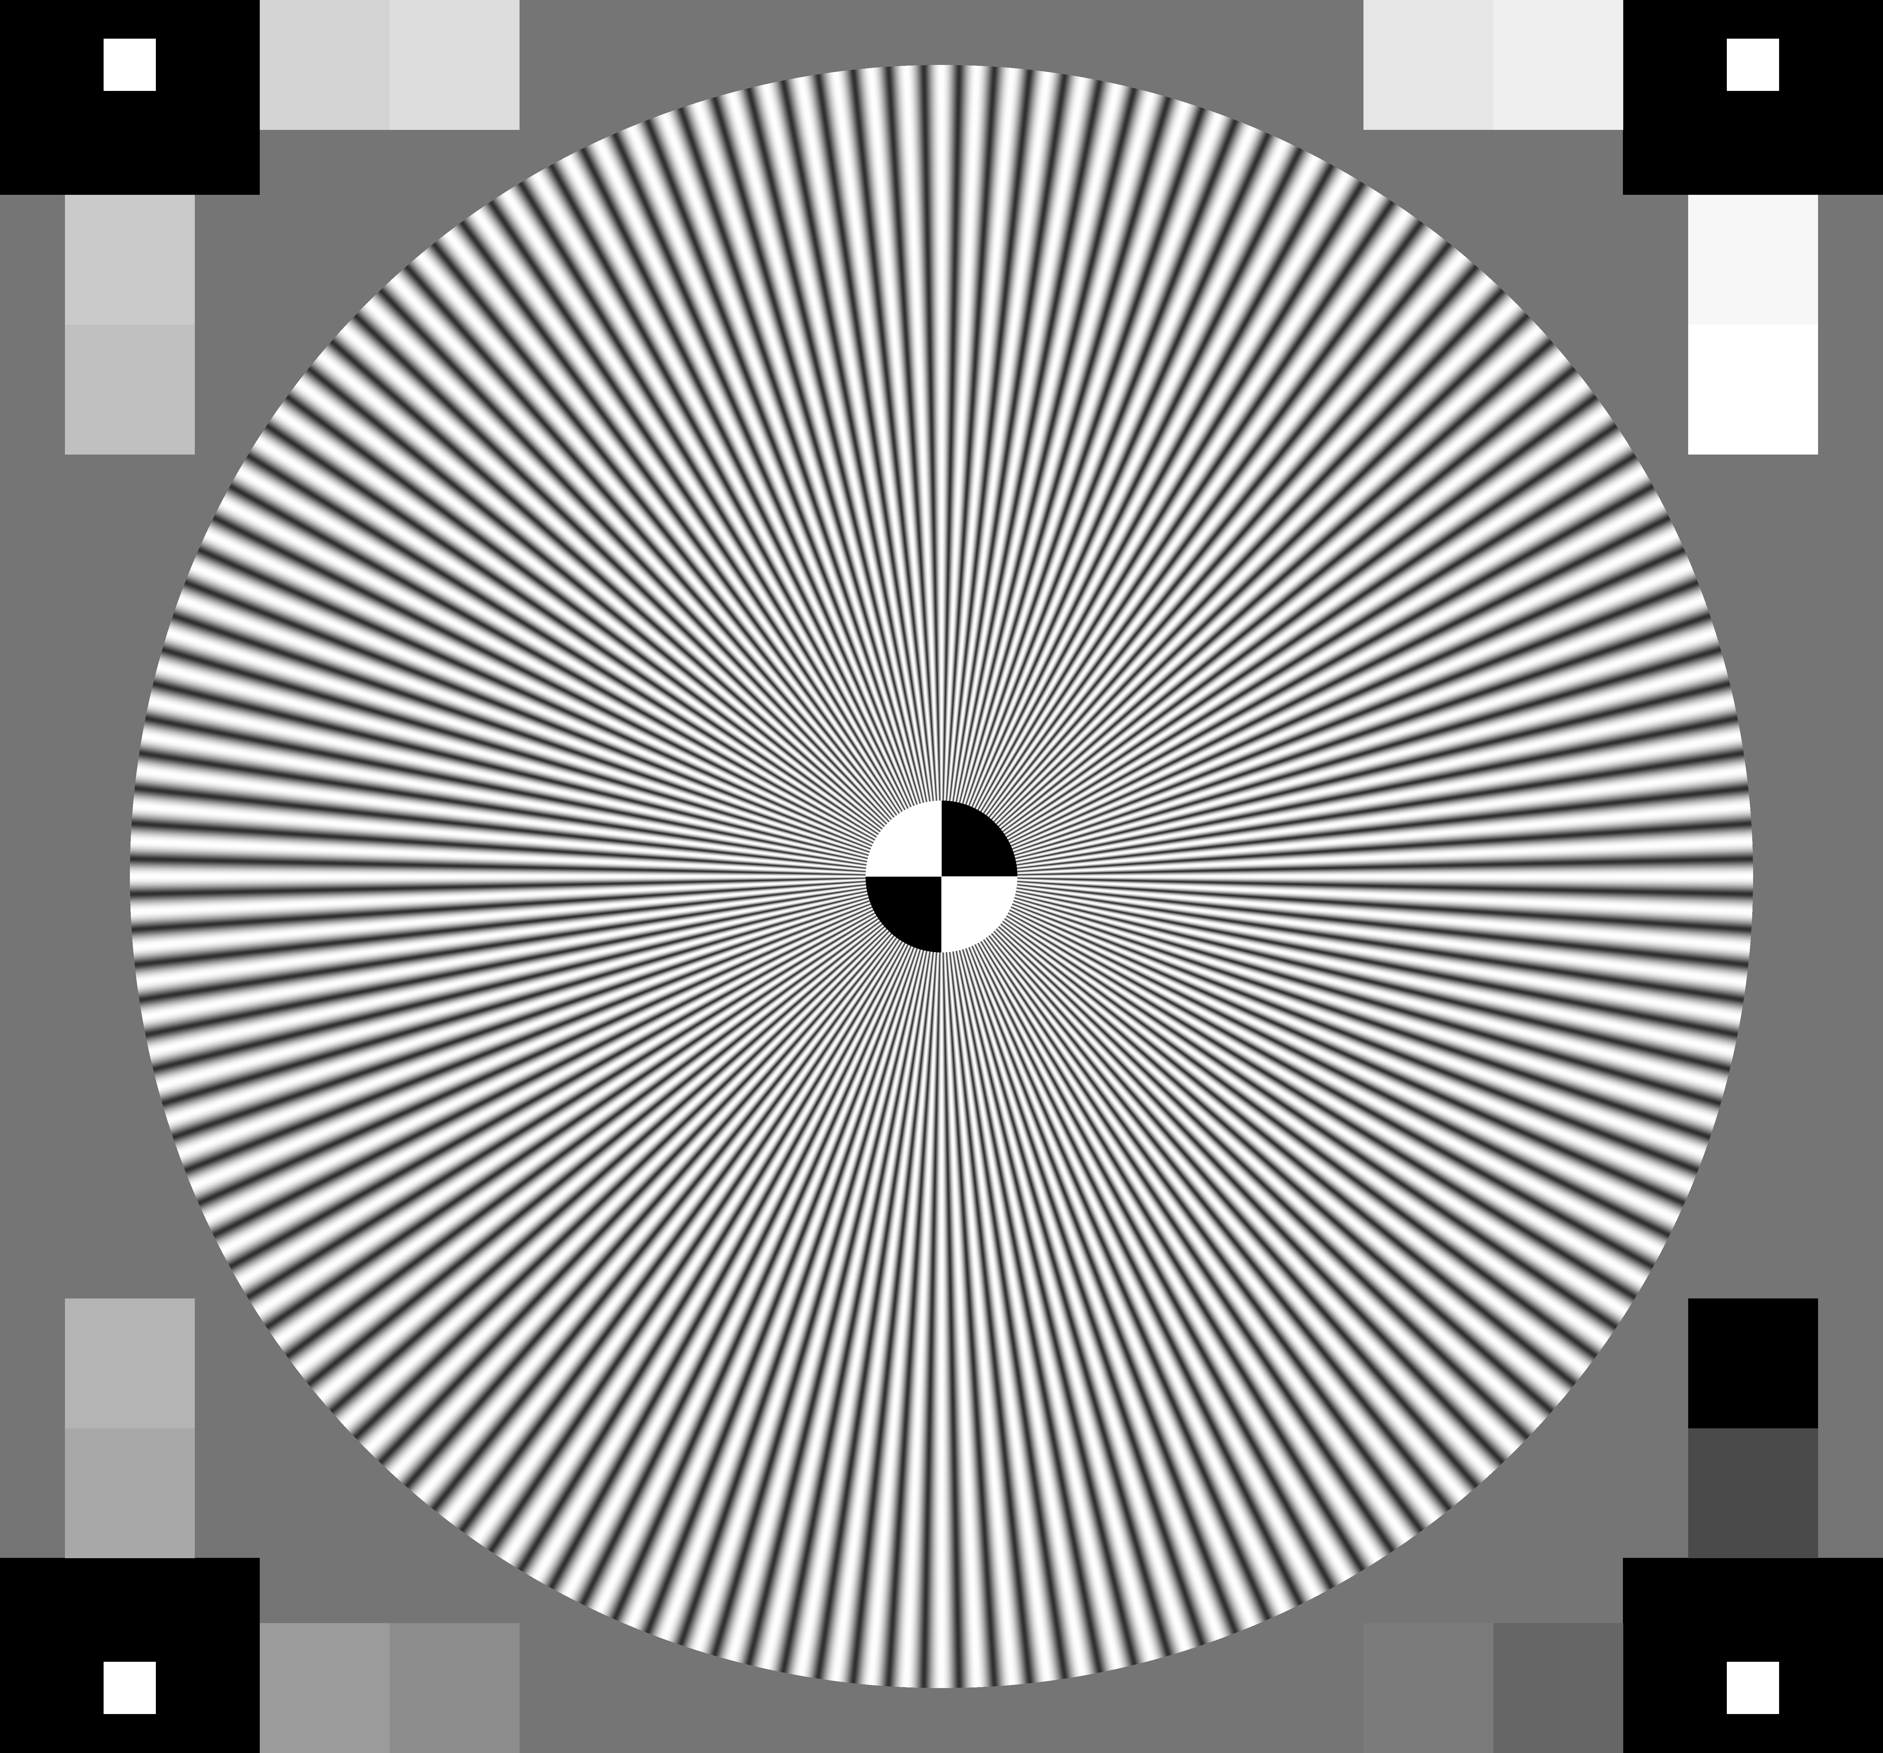
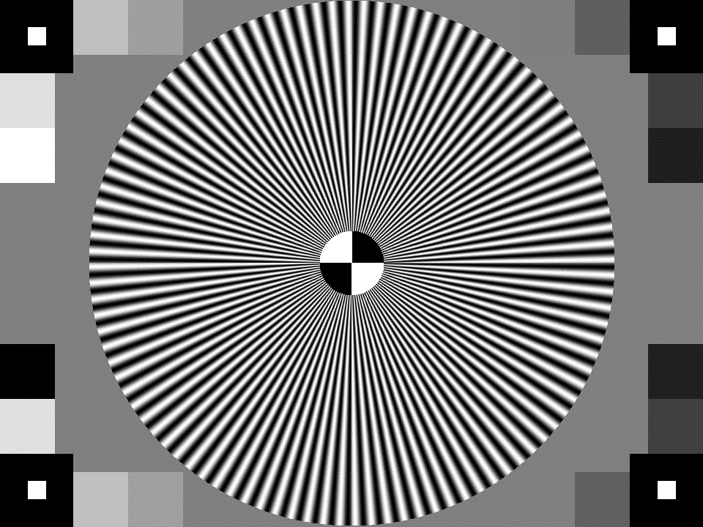
13.1 original TV Test image and our resulted image “grayImage13.bmp”
We know that the code that created the resulted image is not as the lecturer asked for. After consulting with the lecturer – he asked us to write that notation down in the presentation and in the mail!
original TV Test image
our resulted image “grayImage13.bmp”

Slide 3
13.2 Relevant Profiles (of both relevant images) (to prove that image “grayImage13.bmp” was created as required) – part 1
Row view
column view
original
location
RGB values

Slide 4
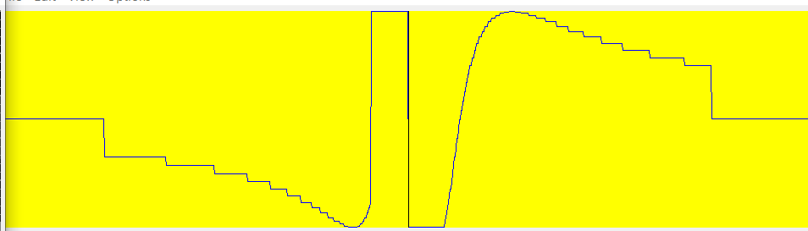
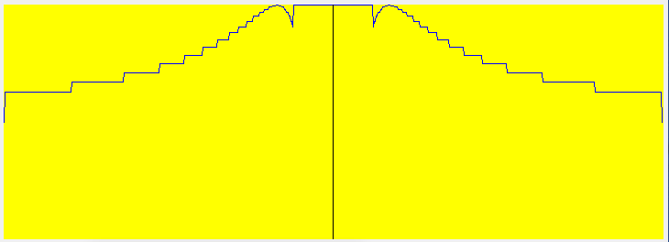
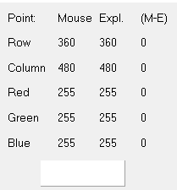
13.2 Relevant Profiles (of both relevant images) (to prove that image “grayImage13.bmp” was created as required) – part 2
new
Row (left and right)
Column (up and down)
location
RGB values

Slide 5
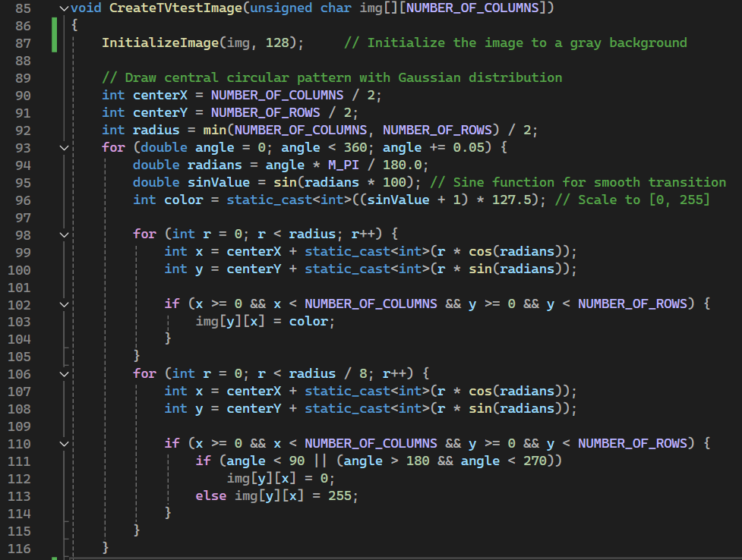
13.3 Code of the function “CreateTVtestImage” – part 1
In the CreateTVtestImage function – there are 3 major components to be created:
Initialization
Central Circular Pattern
Grayscale Blocks
Each will be explained deeper in the 2 next slides

Slide 6

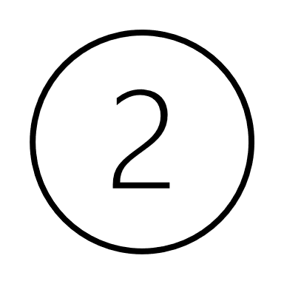
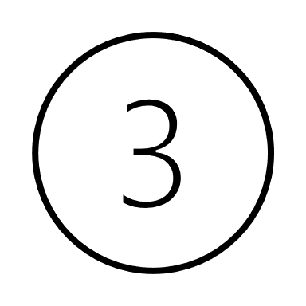

13.3 Code of the function “CreateTVtestImage” – part 2
Initialization:
The function starts by calling InitializeImage(img, 128) to set all pixels to a medium gray value (128).
The CreateTVtestImage function initializes an image with a gray background.
Central Circular Pattern:
The center of the image is calculated, and a circular pattern is drawn using a sine function to create a smooth transition of colors.
A loop runs through angles from 0 to 360 degrees in small increments (0.05 degrees).
For each angle, the sine function is used to determine the color intensity.
Two nested loops draw circles: one for the full radius and one for a smaller radius (1/8th of the full radius) to create alternating black and white segments.

Slide 7
13.3 Code of the function “CreateTVtestImage” – part 3
Grayscale Blocks:
Four black rectangles are added at the corners of the image.
Will be marked as:
Four white inner squares are added near the corners.
Will be marked as:
16 gray rectangles are added at the edges of the image, with varying gray levels.
Will be marked as:

Slide 8
CreateTVtestImage
Start CreateTVtestImage Function Entry point of the function that generates a test image for TV display.
InitializeImage img
Initialize the input image array to a gray background with a value of 128.
Determine the center coordinates of the image
centerX = NUMBER_OF_COLUMNS / 2
centerY = NUMBER_OF_ROWS / 2
Determine the radius of the circular pattern
radius = min (NUMBER_OF_COLUMNS, NUMBER_OF_ROWS )/ 2
Draw the circular pattern with a Gaussian distribution
- Iterate through angles from 0 to 360 degrees
- Calculate the sine value for a smooth transition
- Scale the sine value to the range <0, 255> to get the color
- Draw pixels along the circular path using the calculated color
Draw radial lines within the circular pattern
- Iterate through a smaller radius / 8
- Draw alternating black and white lines based on the angle

Slide 9
Determine the coordinates of the corner blocks
- 4 black corner blocks with a size of 100 pixels
Add the black corner blocks to the image using AddGrayRectangle
Add the white inner blocks to the image using AddGrayRectangle
Determine the coordinates of the white inner blocks
4 white inner blocks with a size of 25 pixels blockSize / 4
Determine the coordinates of the edge blocks
- 16 edge blocks with varying gray levels
End CreateTVtestImage Function
The function has completed the generation of the test image.

Slide 10
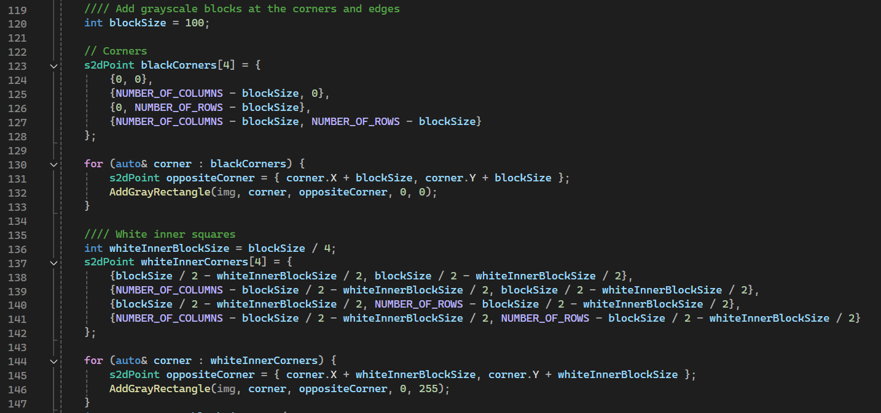
13.3 Code of the function “CreateTVtestImage” – part 2

Slide 11
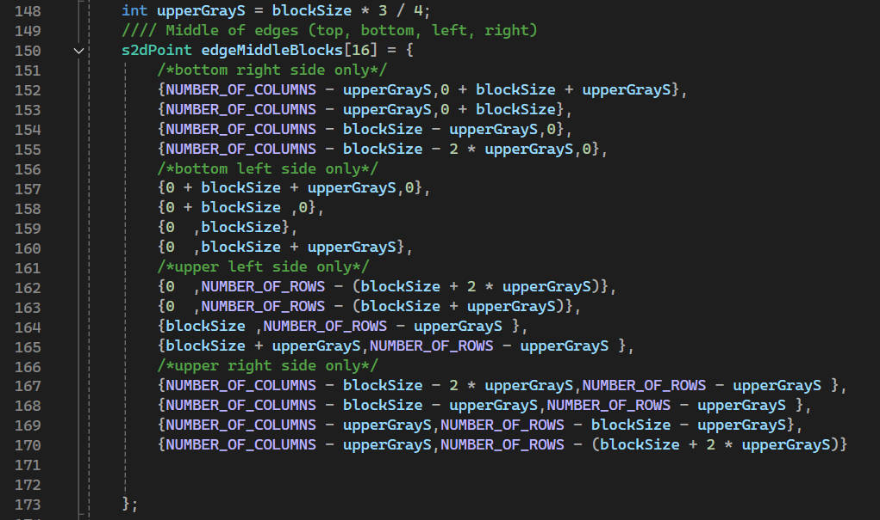
13.3 Code of the function “CreateTVtestImage” – part 3

Slide 12
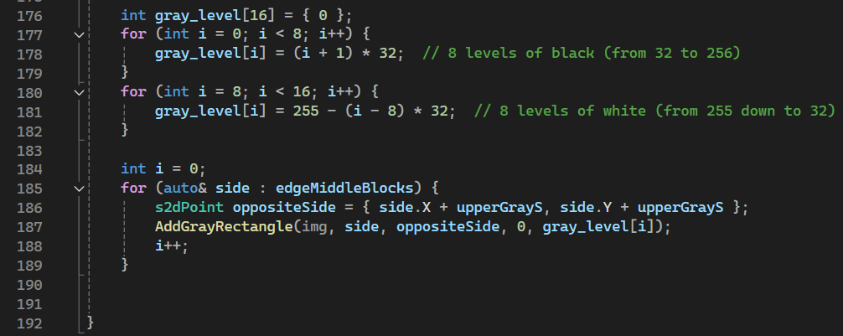
13.3 Code of the function “CreateTVtestImage” – part 4

Slide 13
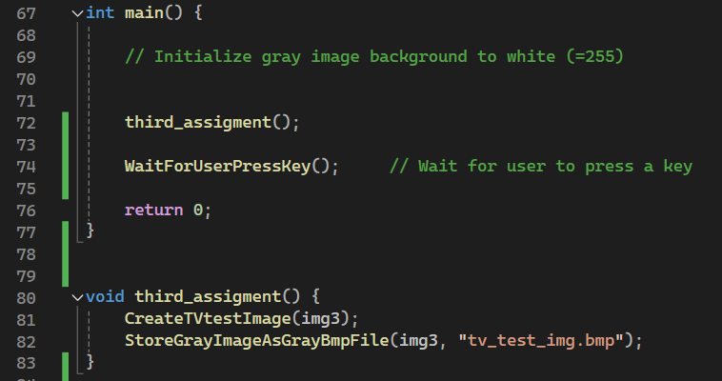
13.4 Code of the main function

Slide 14
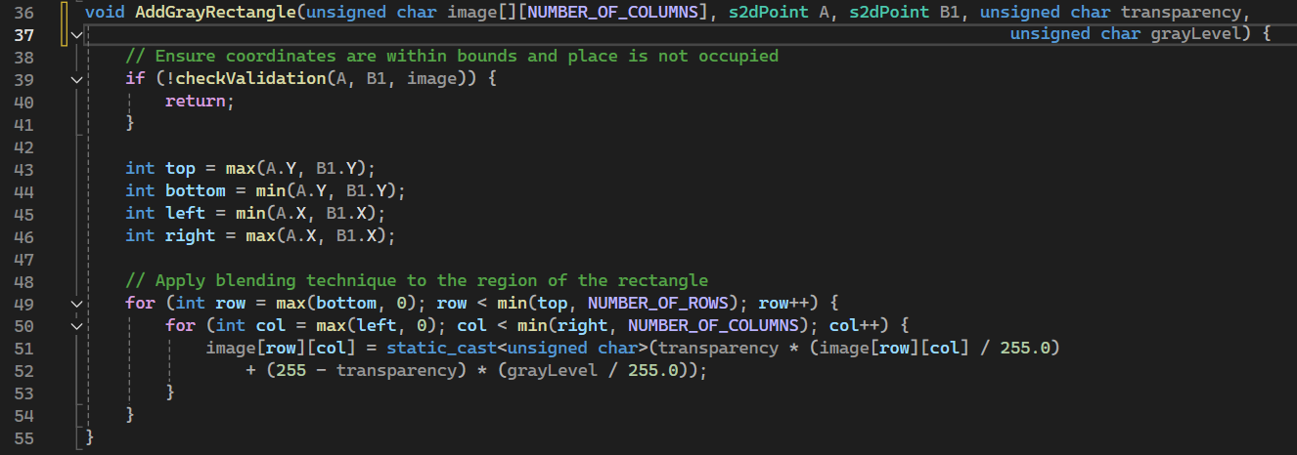
(+) additional necessary functions – part 1

Slide 15
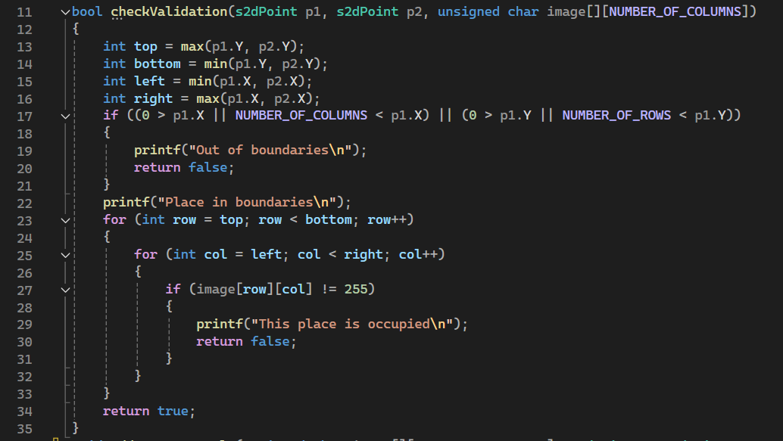
(+) additional necessary functions – part 2
Purpose: Validates whether a rectangular region defined by two points p1 and p2 lies within the image boundaries and checks if the area is unoccupied (= all pixels in the region have the value 255).
The function takes two points p1 and p2, and a 2D array image with dimensions [NUMBER_OF_ROWS][NUMBER_OF_COLUMNS] as arguments.
It returns a boolean value indicating whether the region is valid and unoccupied.
The function checks if p1 is within the image boundaries. If any coordinate of p1 is out of bounds, it prints "Out of boundaries" and returns false.
If the points are within boundaries, it prints "Place in boundaries".

Slide 16
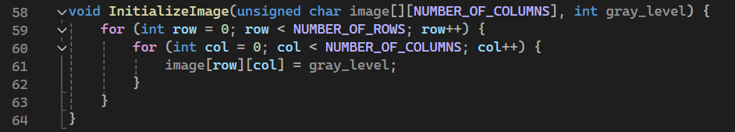
(+) additional necessary functions – part 3
The function takes a 2D array image with dimensions [NUMBER_OF_ROWS][NUMBER_OF_COLUMNS] and an integer gray_level as arguments.
The function uses two nested for loops to iterate through each pixel in the image.
Within the inner loop, each pixel at position [row][col] is set to the specified gray_level.
This effectively fills the entire image with the same gray level, creating a uniform gray background.

Slide 17
13.5 What did we learned?

